Slide 1
Notes for clarification and consideration
These initial scenarios intend to put on the table as many creative possibilities to best use buildings for making disciples, building communities, and inspiring witness.
These are initial scenarios. Your Grouping Feedback & Discernment Team may develop / consider additional scenarios it believes are viable and merit discussion.
Between meetings, pray with the scenarios and process both your emotions and logical reactions.

Slide 2
Notes for clarification and consideration
In any scenario with two or more parishes uniting, one of the churches must be designated the parish church where the sacramental records for the parish would be kept.
When multiple churches would continue to host a regular schedule of Mass(es), which church would be designated the parish church is generally not noted in these initial scenarios. Commentary on that issue can be included in your feedback.
When parishes unite, the assets of each parish uniting together become assets of the united parish.
Please note the scenarios do not propose changes to any of the schools. Some scenarios may require discussion about school governance / relationship to parish, but no changes are proposed to school structures nor programs.

Slide 3
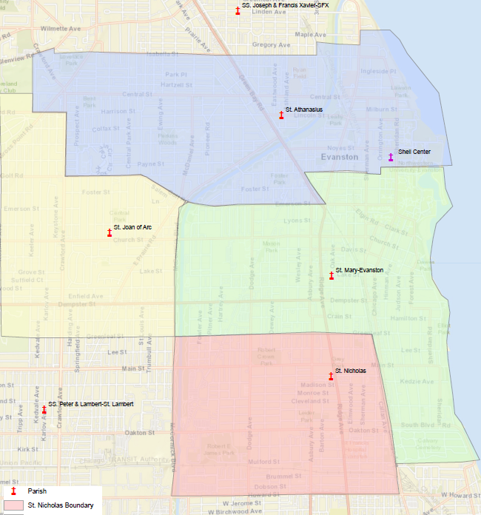
Evanston
Current Structure
St. Athanasius
Sheil Center
St. Joan of Arc
St. Mary
St. Nicholas

Slide 4
Scenario 1: Sheil + 2 parishes
St. Athanasius + St. Joan of Arc + St. Mary configuration scenarios:
Continue using all 3 sites
Use 2 sites
Unite all Masses at 1 site
St. Athanasius + St. Joan of Arc + St. Mary
Sheil Center remains separate entity
St. Nicholas

Slide 5
Scenario 2: Sheil + 2 parishes
Sheil Center remains separate entity
St. Athanasius + St. Joan of Arc:
2 sites or 1 site.
St. Mary +
St. Nicholas
2 sites

Slide 6
Scenario 3: 3 parishes, connecting Sheil campus ministry with parish
St. Athanasius + St. Joan of Arc:
2 sites or 1 site.
St. Mary + Sheil Center unite with two locations
St. Mary + Sheil priest staffing:
1 priest leader with dual roles (Pastor + Sheil Director)
2 priests (Pastor and Sheil Director)
St. Nicholas

Slide 7
Scenario 4: 3 parishes, connecting Sheil campus ministry with parish
St. A’s + Sheil priest staffing:
1 priest leader with dual roles (Pastor + Sheil Director)
2 priests (Pastor and Sheil Director)
St. Athanasius + Sheil Center unite with two locations
St. Joan of Arc + St. Mary.
2 sites or 1 site
St. Nicholas

